Slide 1
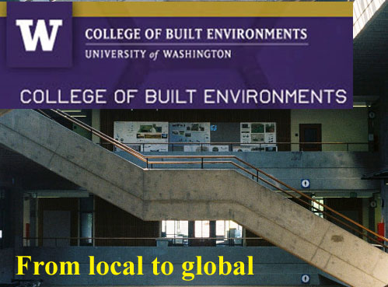
Graduate Certificate in Real Estate

Slide 2
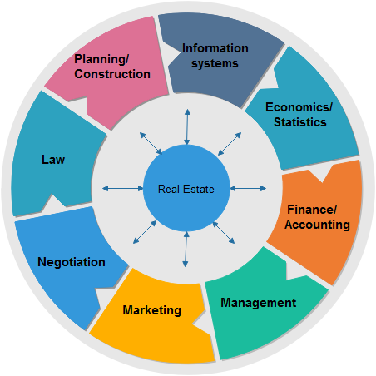
What does a Real Estate Team Need to Know?
GRADUATE CERTIFICATE IN REAL ESTATE

Slide 3
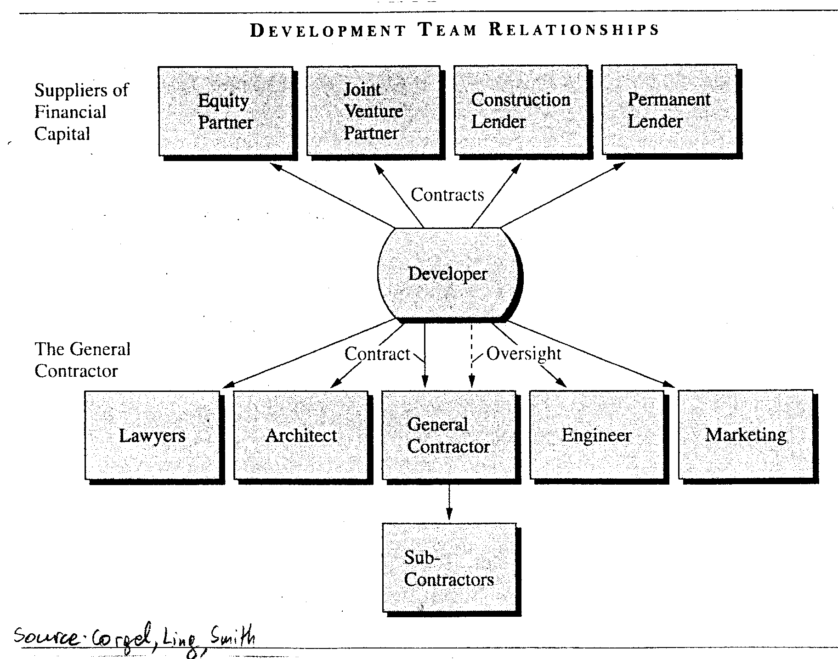
Development team
GRADUATE CERTIFICATE IN REAL ESTATE
Source: Corgel J., Ling D., Smith H., (2001), Real Estate Perspectives – An introduction to Real Estate, McGraw-Hill

Slide 4
Why should you be interested?
Audience is non-real estate students with diverse backgrounds
Purpose:
Engage non-real estate students in exploring the interdisciplinary nature of real estate;
Facilitate the understanding of fundamental concepts and cross-discipline collaboration; and
Expand the employability of individuals of various fields contributing to real estate
GRADUATE CERTIFICATE IN REAL ESTATE

Slide 5
What are the learning objectives?
Explore the various real estate types, key industry participants, policies and contributing fields
Highlight the interplay and effect of socioeconomic conditions on real estate markets
Explore the financial structures and instruments utilized among different types of real estate deals
Identify the steps involved and key decisions in the development process
Engage in interdisciplinary simulations similar to professional teams
GRADUATE CERTIFICATE IN REAL ESTATE

Slide 6
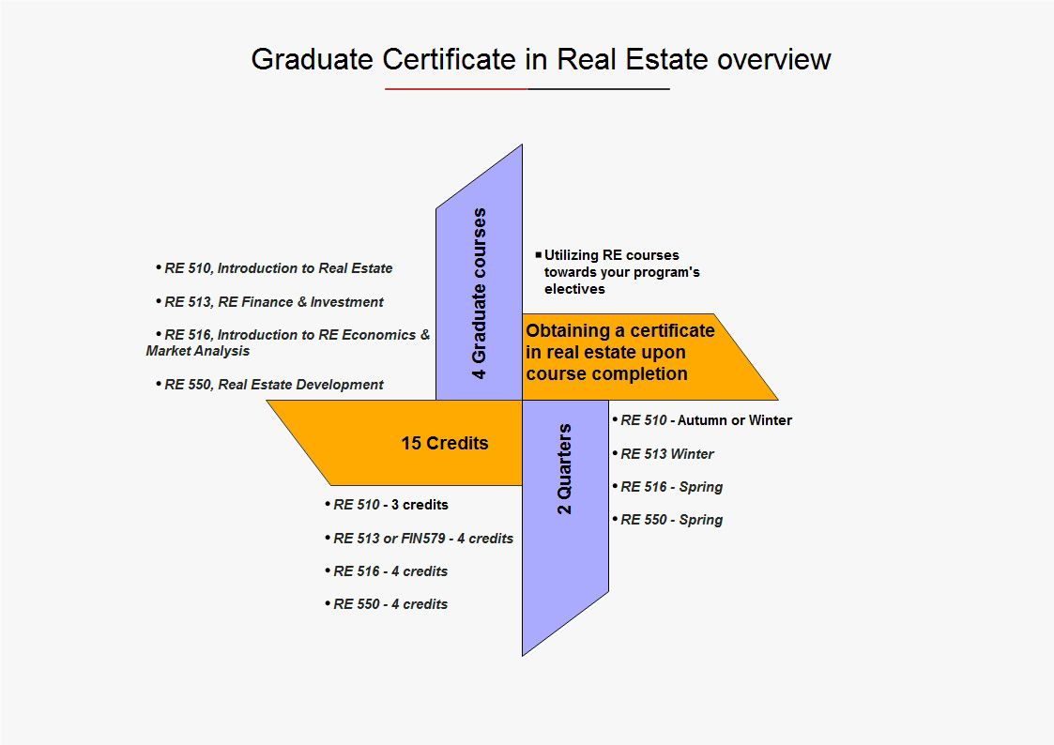
Graduate Certificate in Real Estate overview
GRADUATE CERTIFICATE IN REAL ESTATE

Slide 7
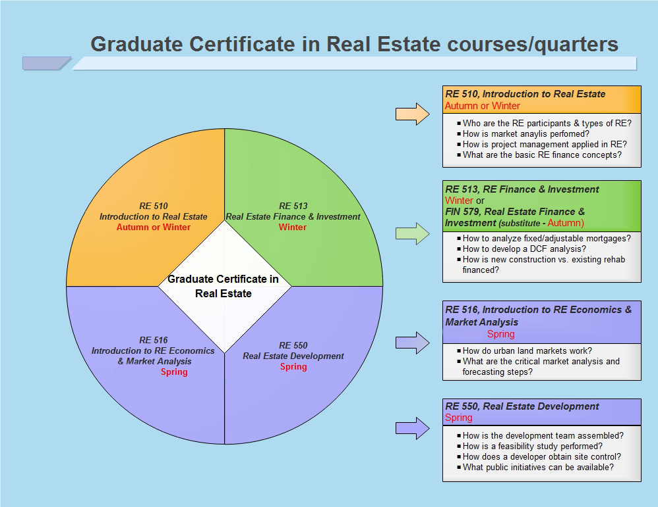
Graduate Certificate in Real Estate courses
GRADUATE CERTIFICATE IN REAL ESTATE

Slide 8
Application logistics
Submission packages should include:
Letter of interest
Current UW transcripts
General logistics:
Students are required to be admitted before taking RE courses to receive the certificate
No course substitution is allowed
Applications will be accepted twice a year (Autumn – Dec. 15th & Spring – May 15th)
Applying graduate students need to be enrolled at UW for at least one quarter when applying to the GCRE
Applications and/or questions:
regradcert@uw.edu
Website:
GRADUATE CERTIFICATE IN REAL ESTATE

