Slide 1
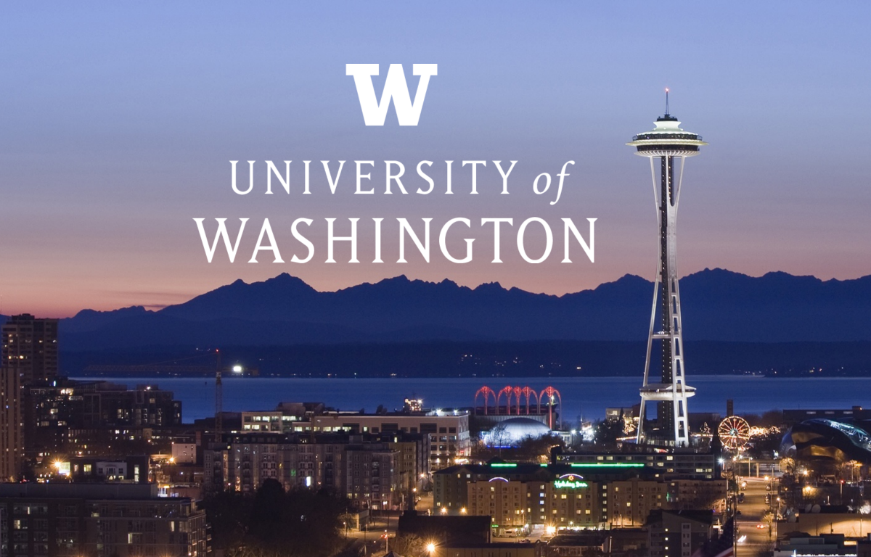
Runstad Department of Real Estate - Master of Science in Real Estate

Slide 2
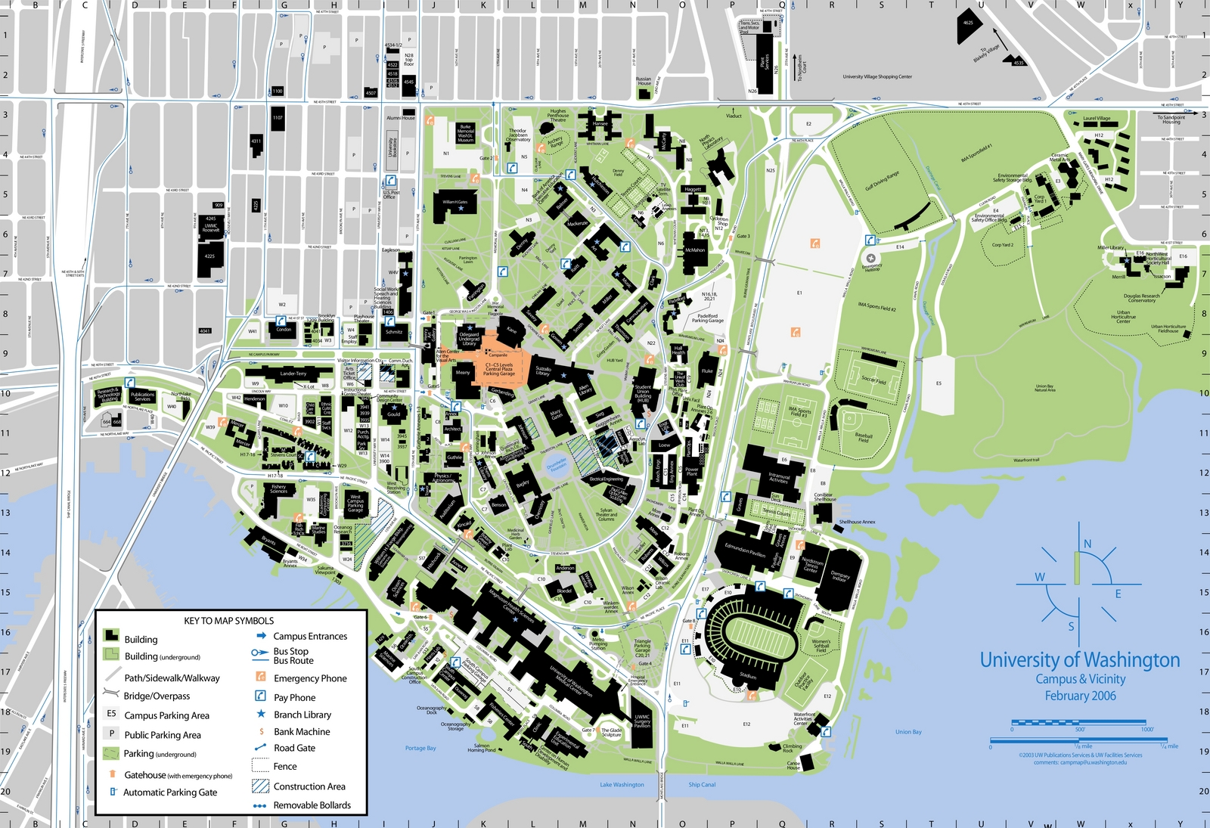
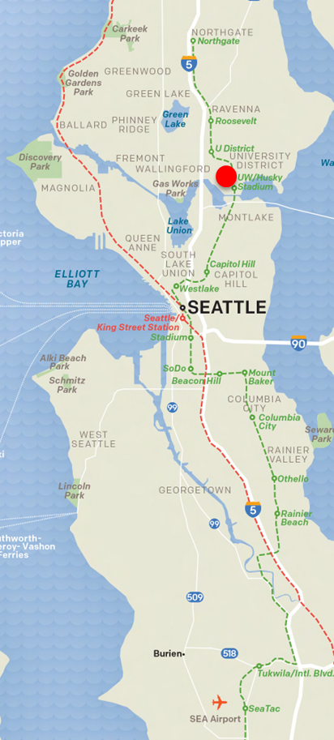
University of Washington

Slide 3
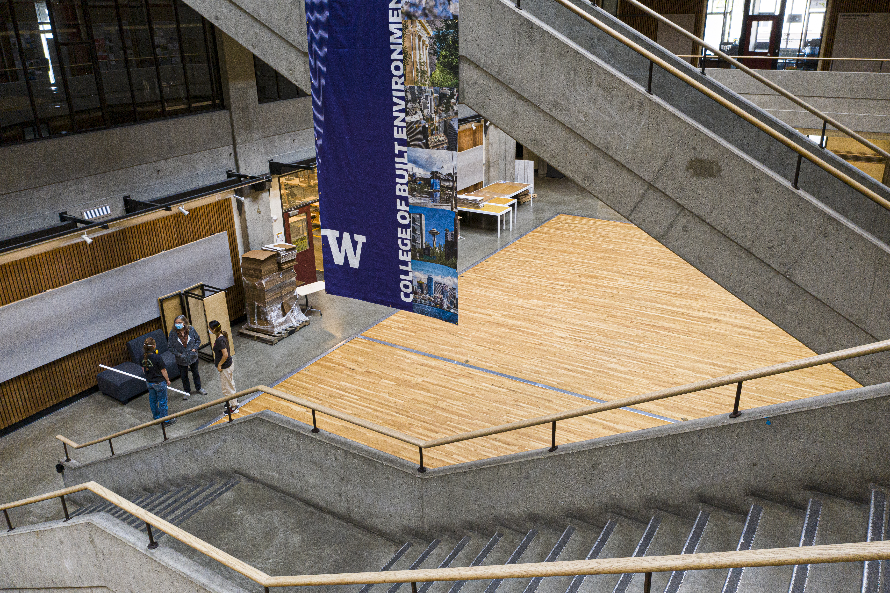
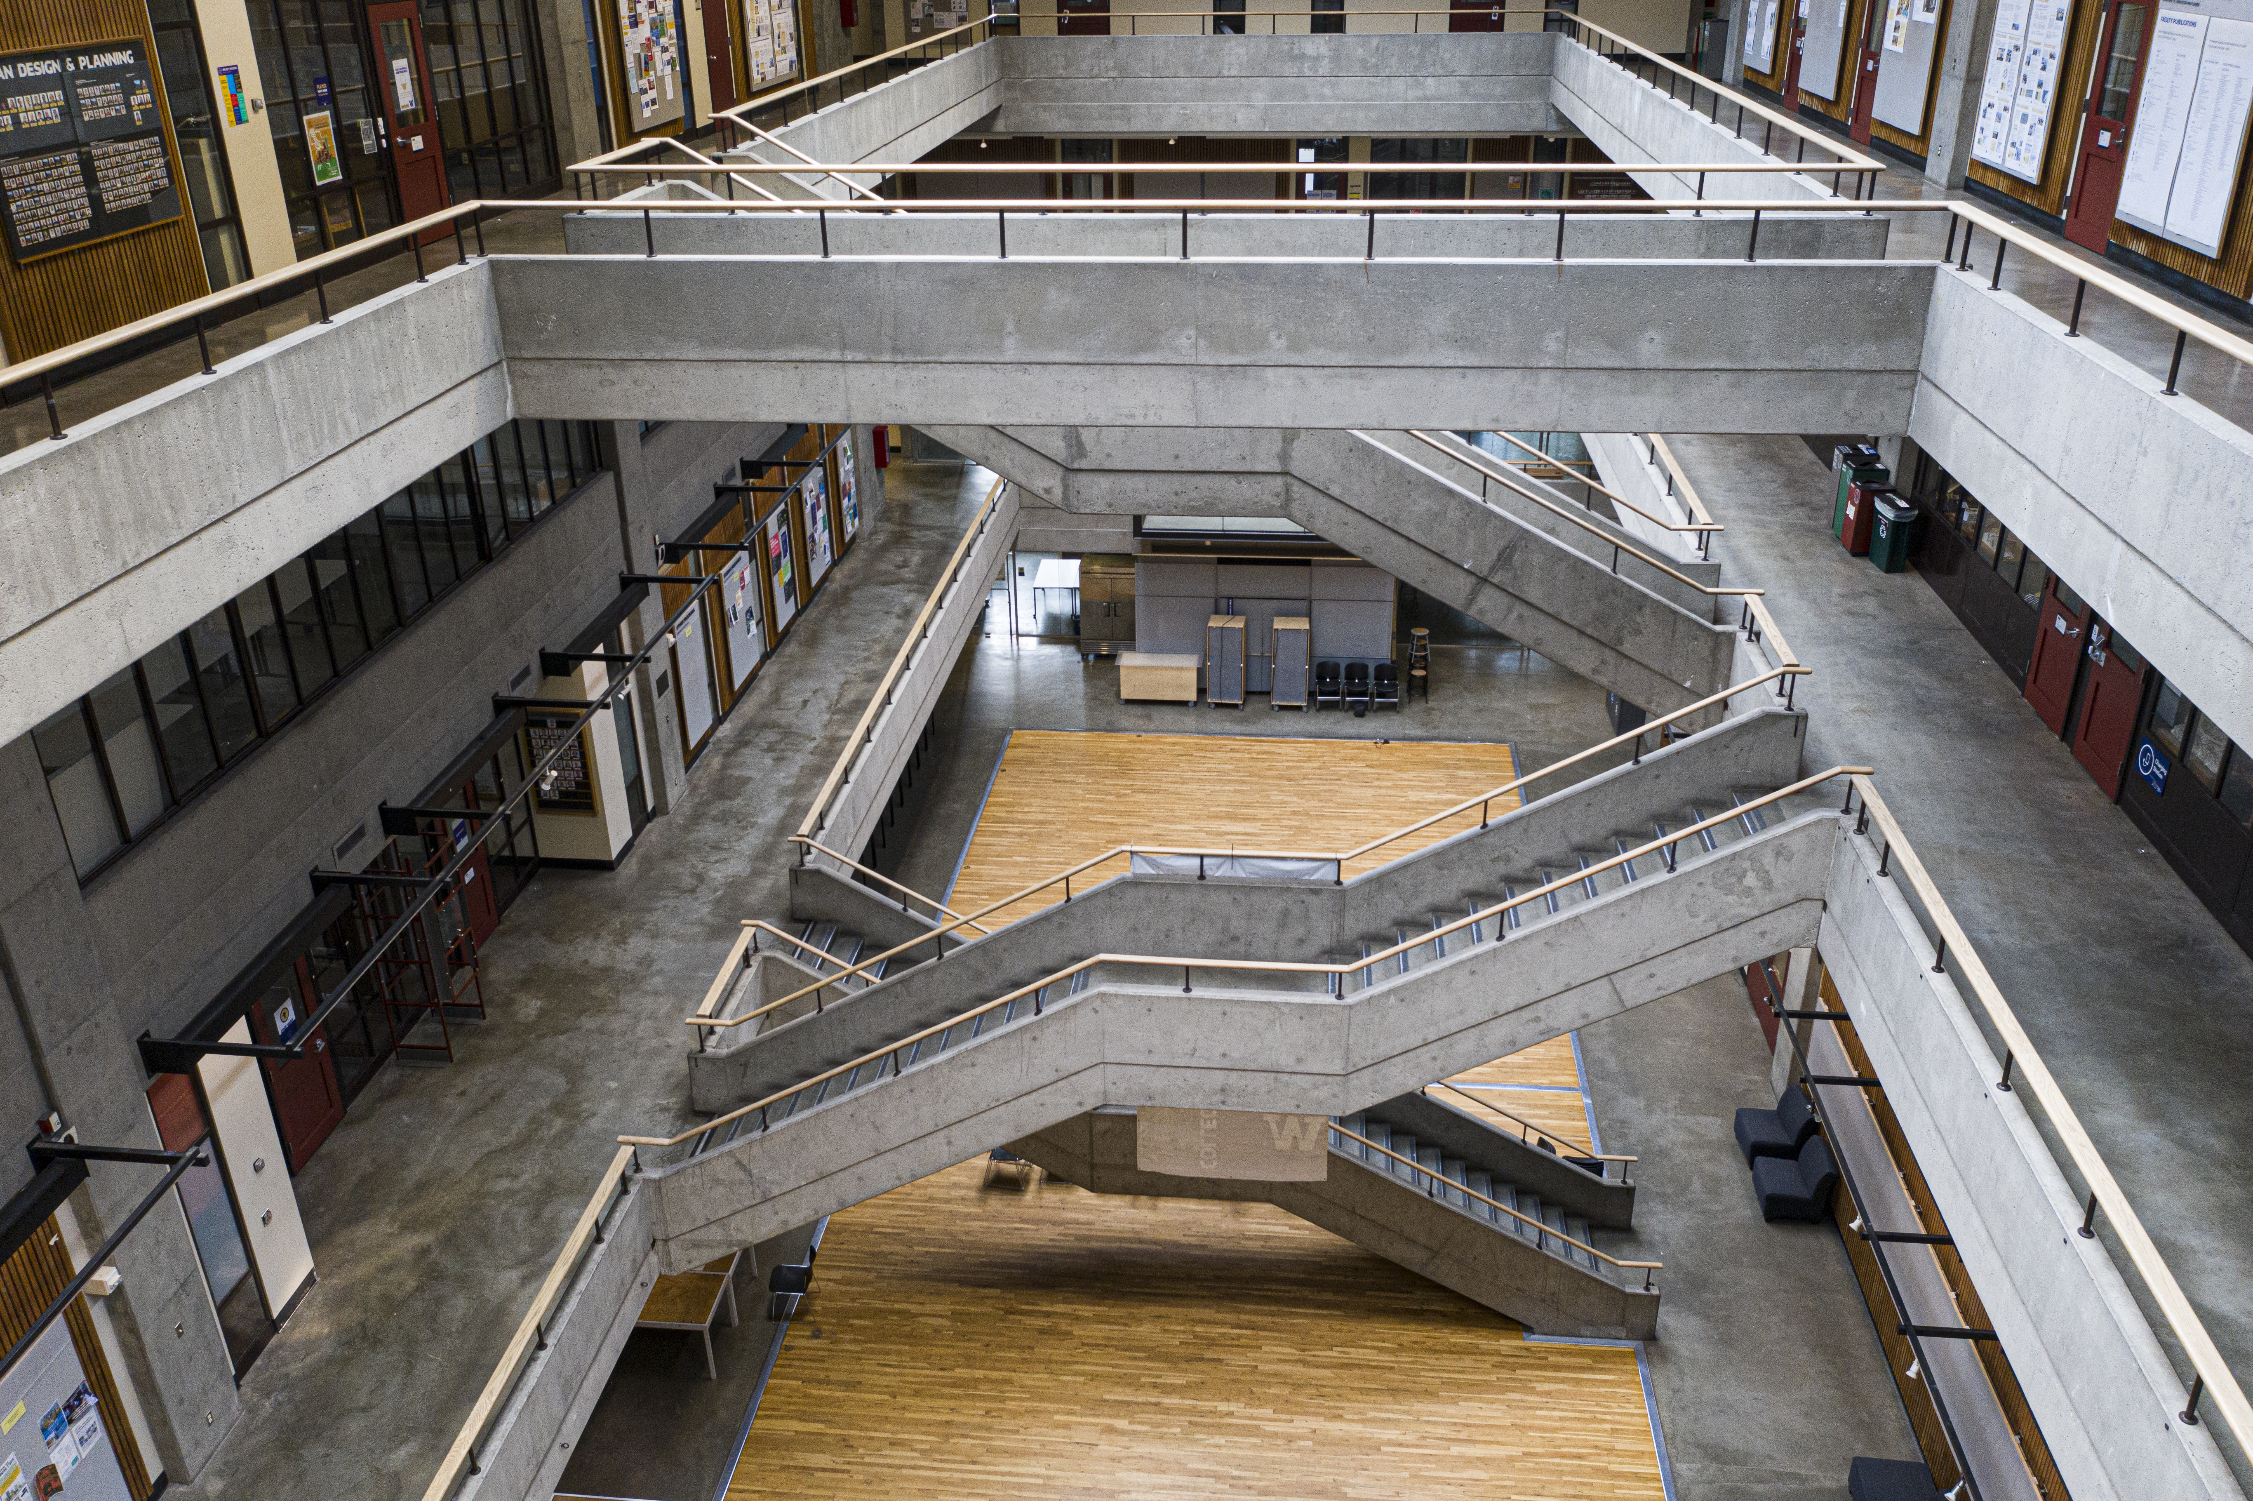
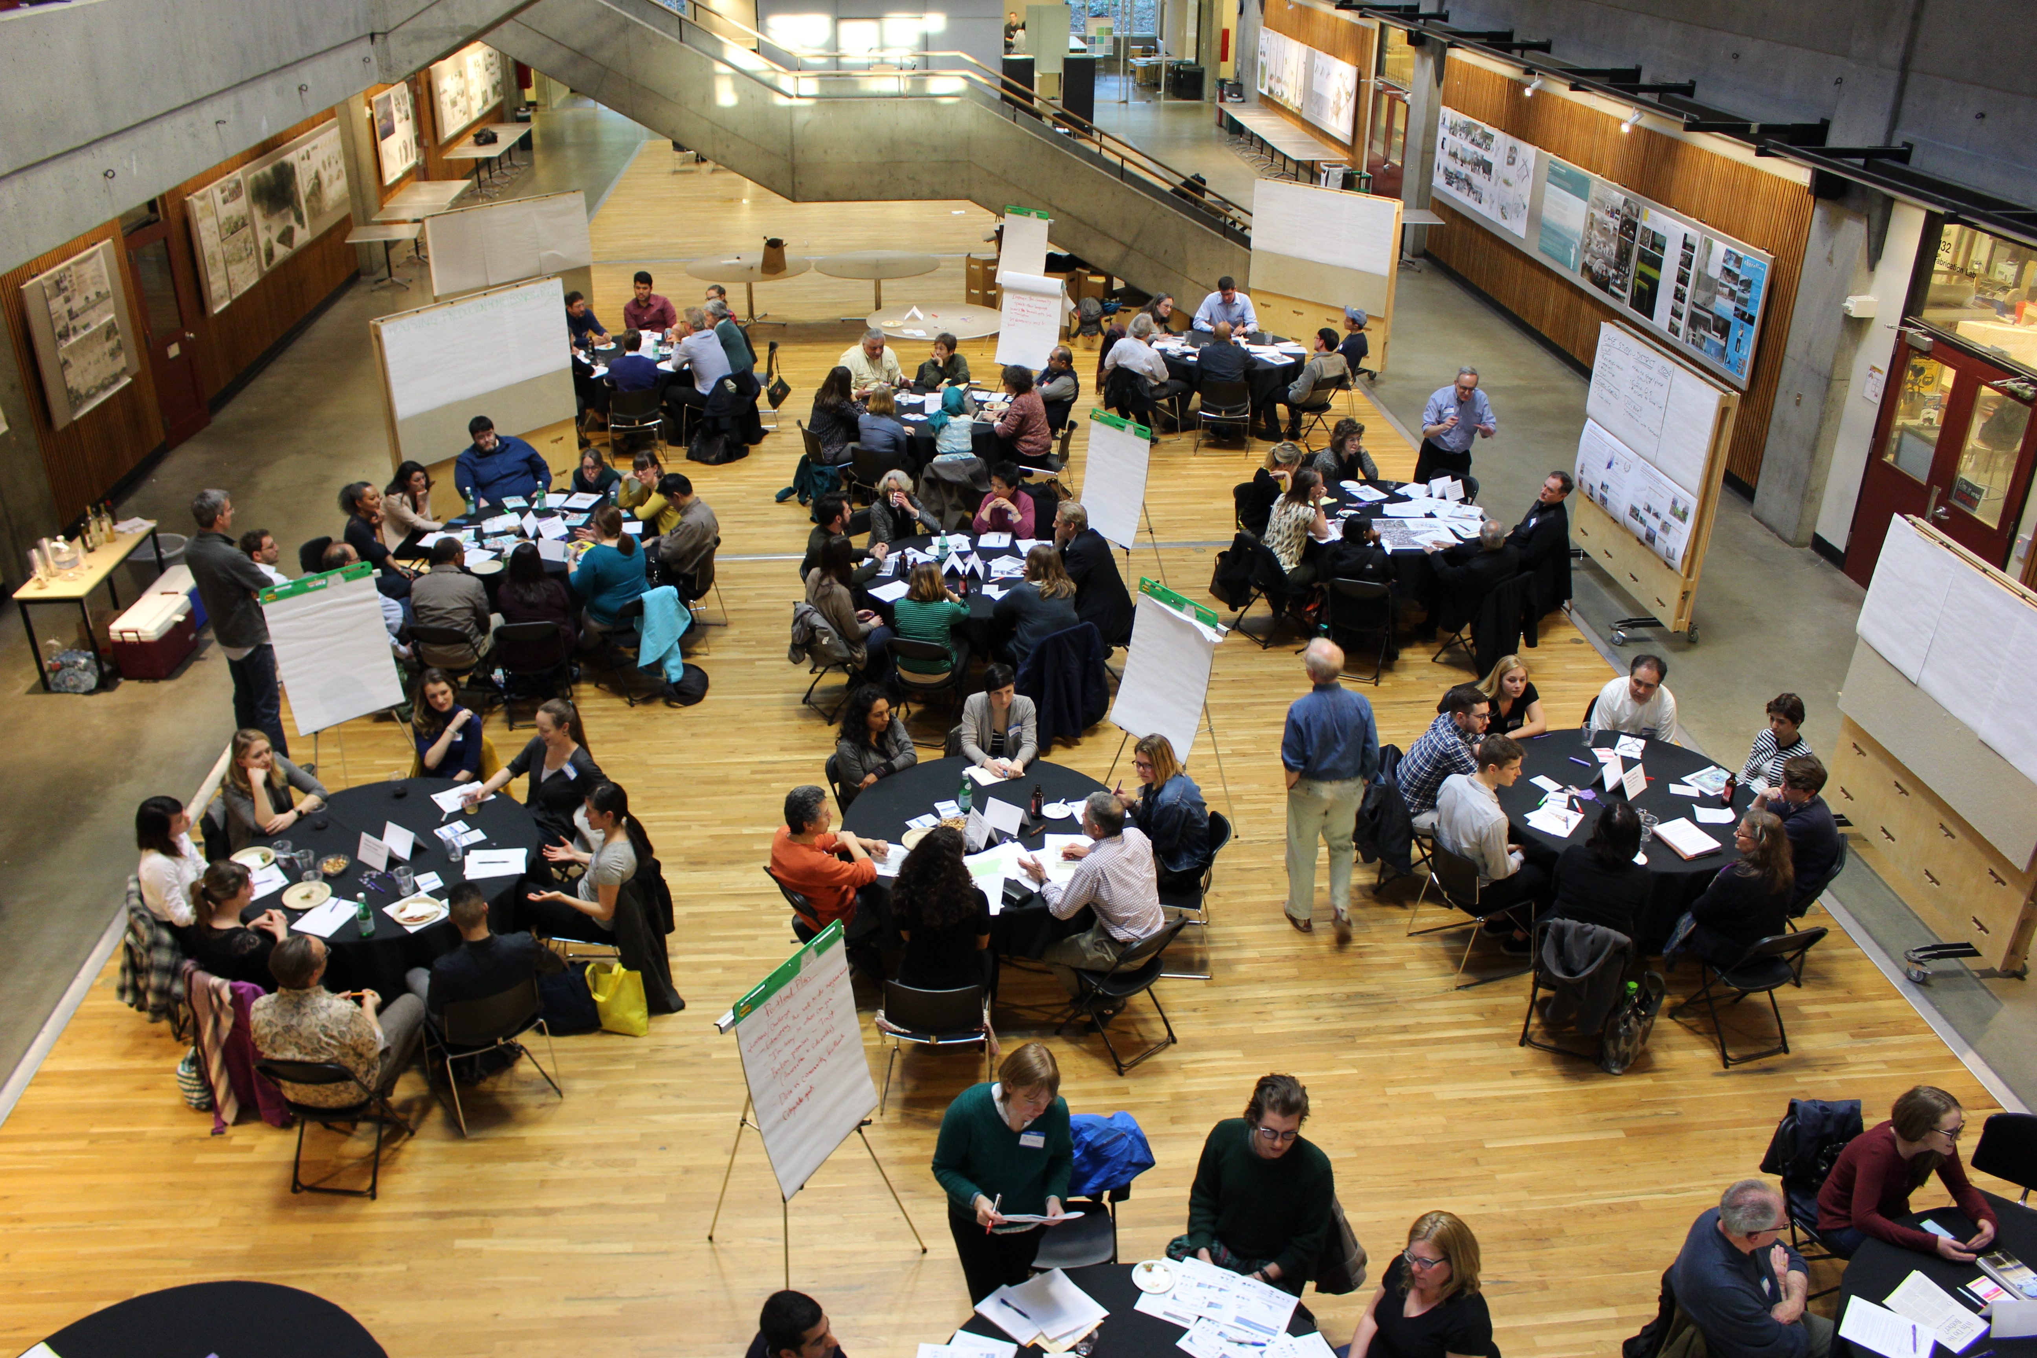
College of Built Environments
5 Departments:
  Architecture
  Landscape Architecture
  Construction Management
  Urban Design and Planning
  Runstad Department of Real Estate
19 degrees: undergraduate, professional, Ph.D. (2)
62 faculty; 850 students
Amenities: Computer lab, library, fabrication shop. Three buildings plus offsite spaces for research and teaching

Slide 4
Runstad Department of Real Estate - UW
Faculty: 6 tenure or tenure-track + several affiliate professionals
Website: https://re.be.uw.edu/
Degrees
  Undergraduate
    Real Estate (minor , major)
  Graduate
    Master of Science in Real Estate
    Master of Science in Real Estate with the University of Regensburg
    Graduate Certificate in Real Estate
    Graduate Certificate in Housing Studies

Slide 5
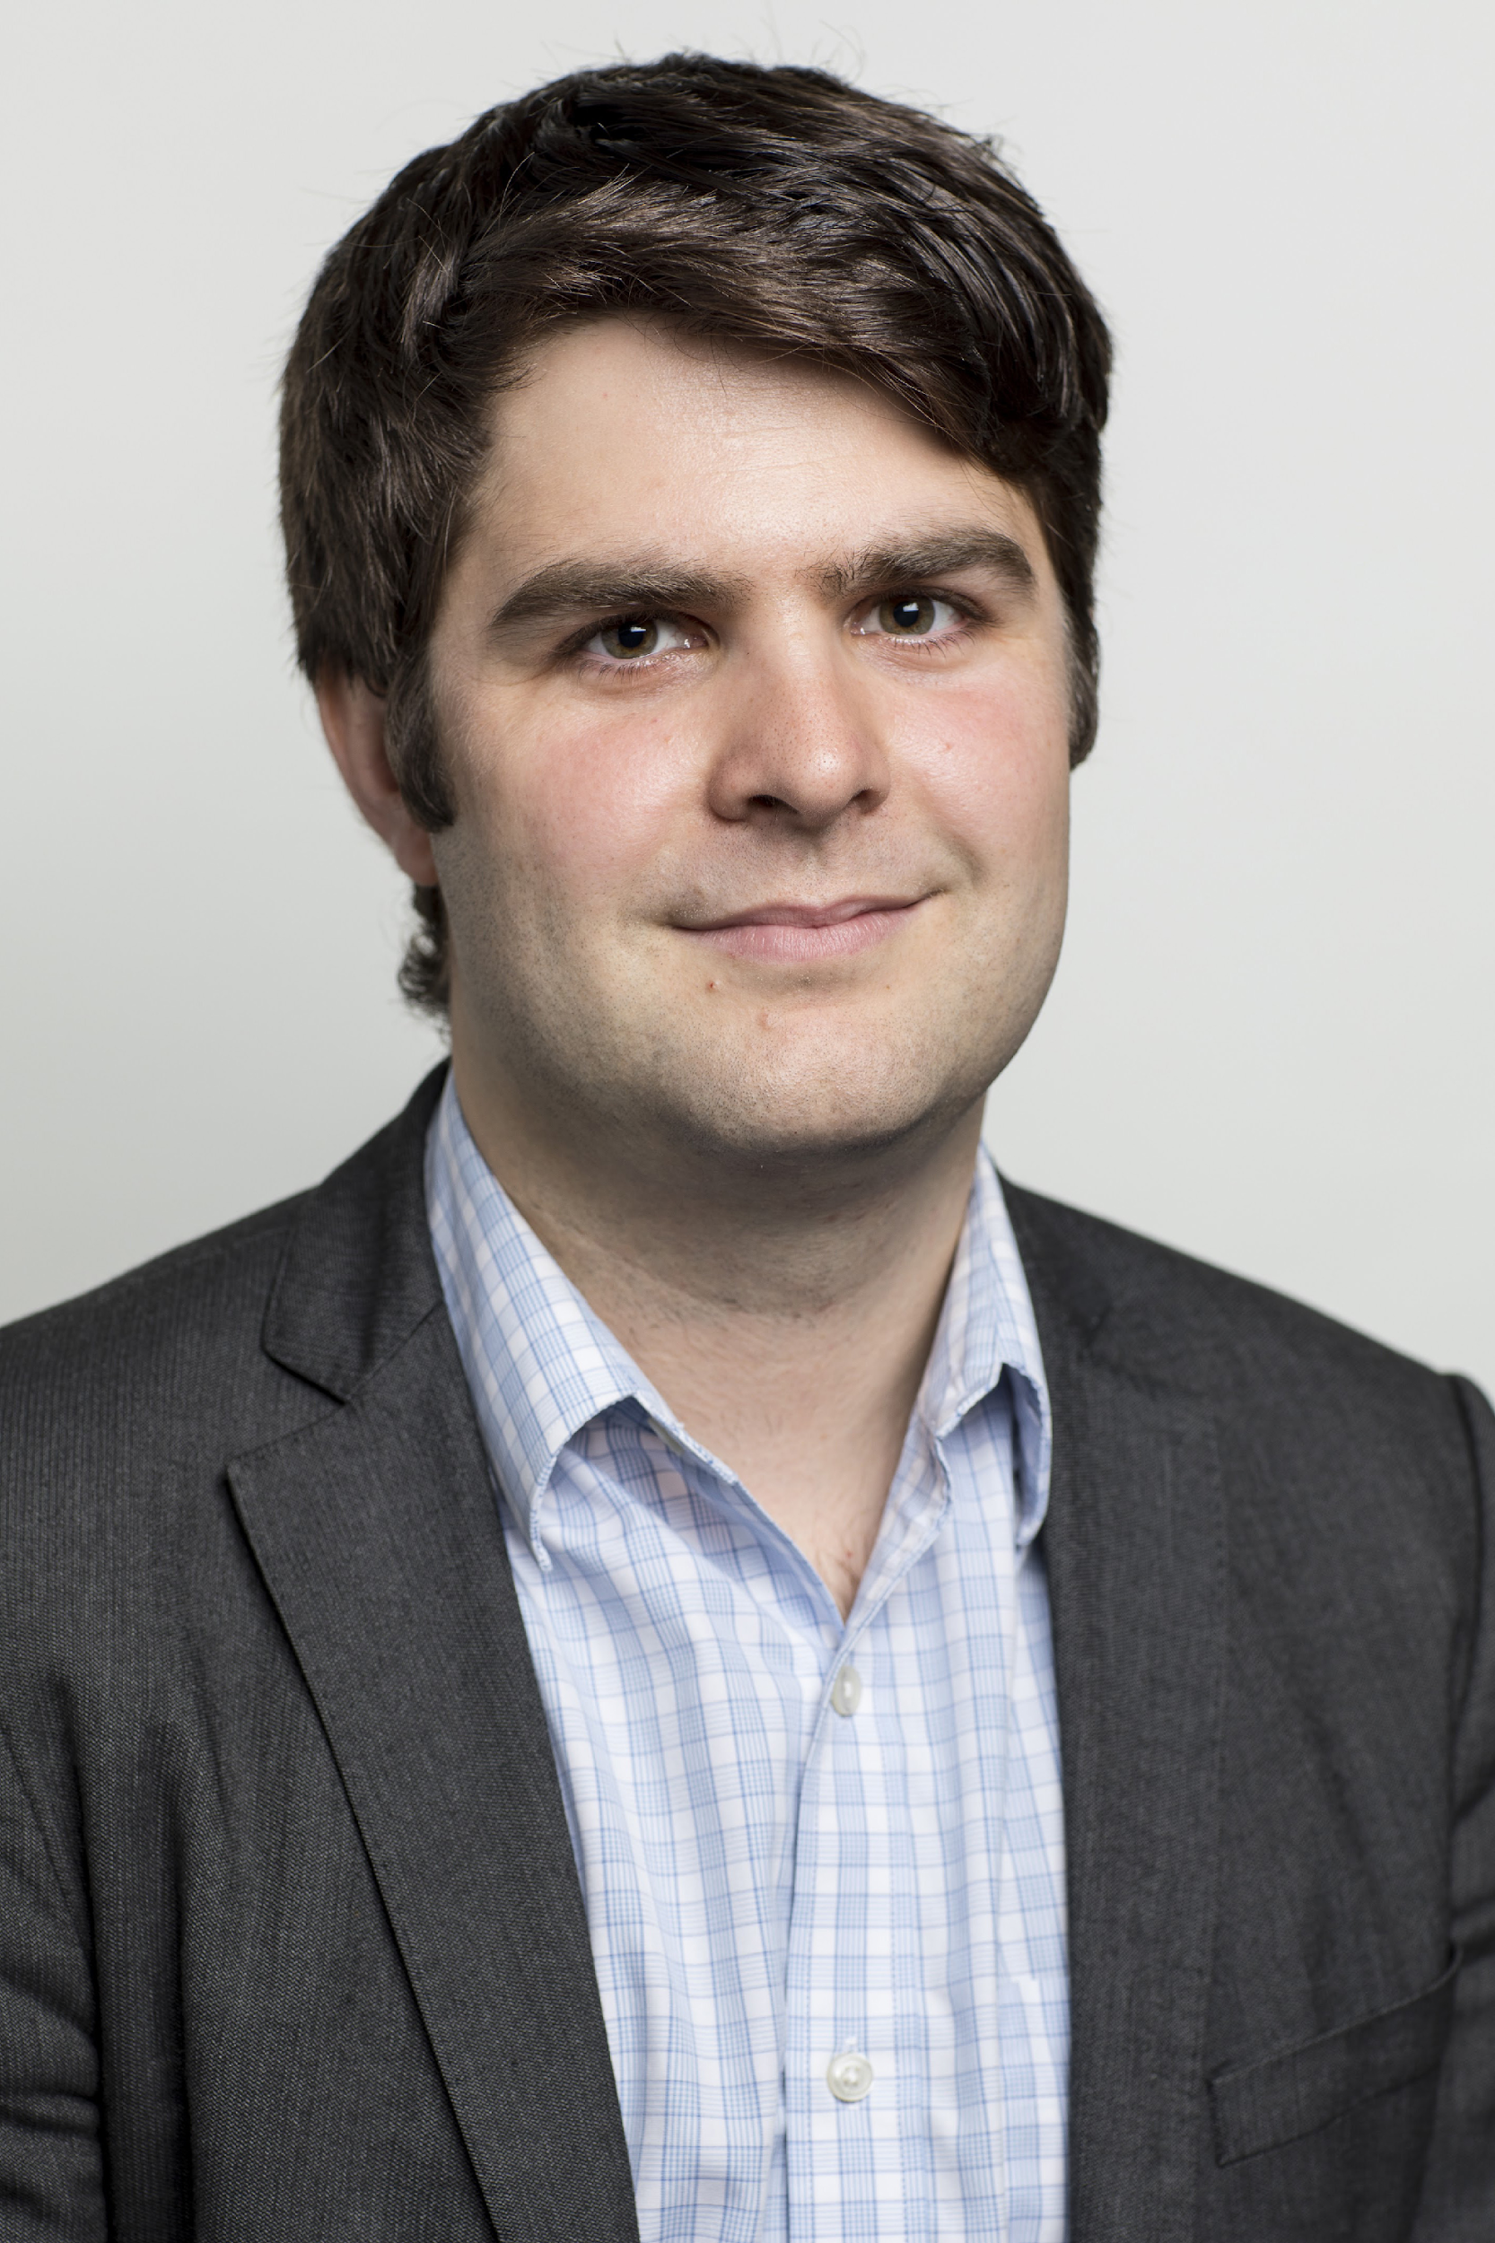

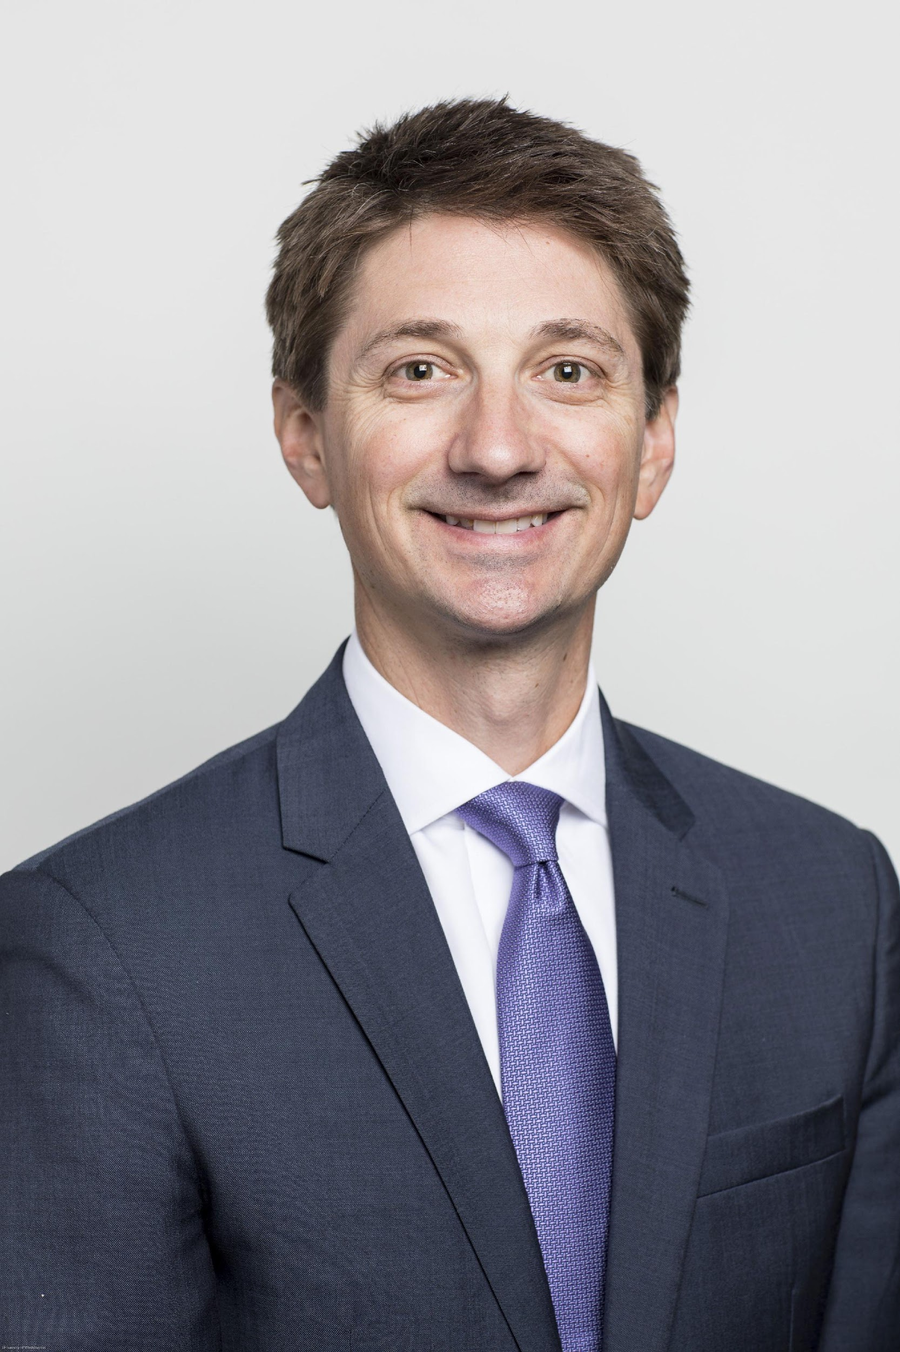
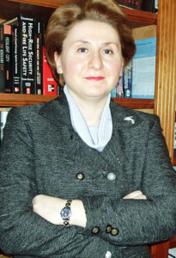
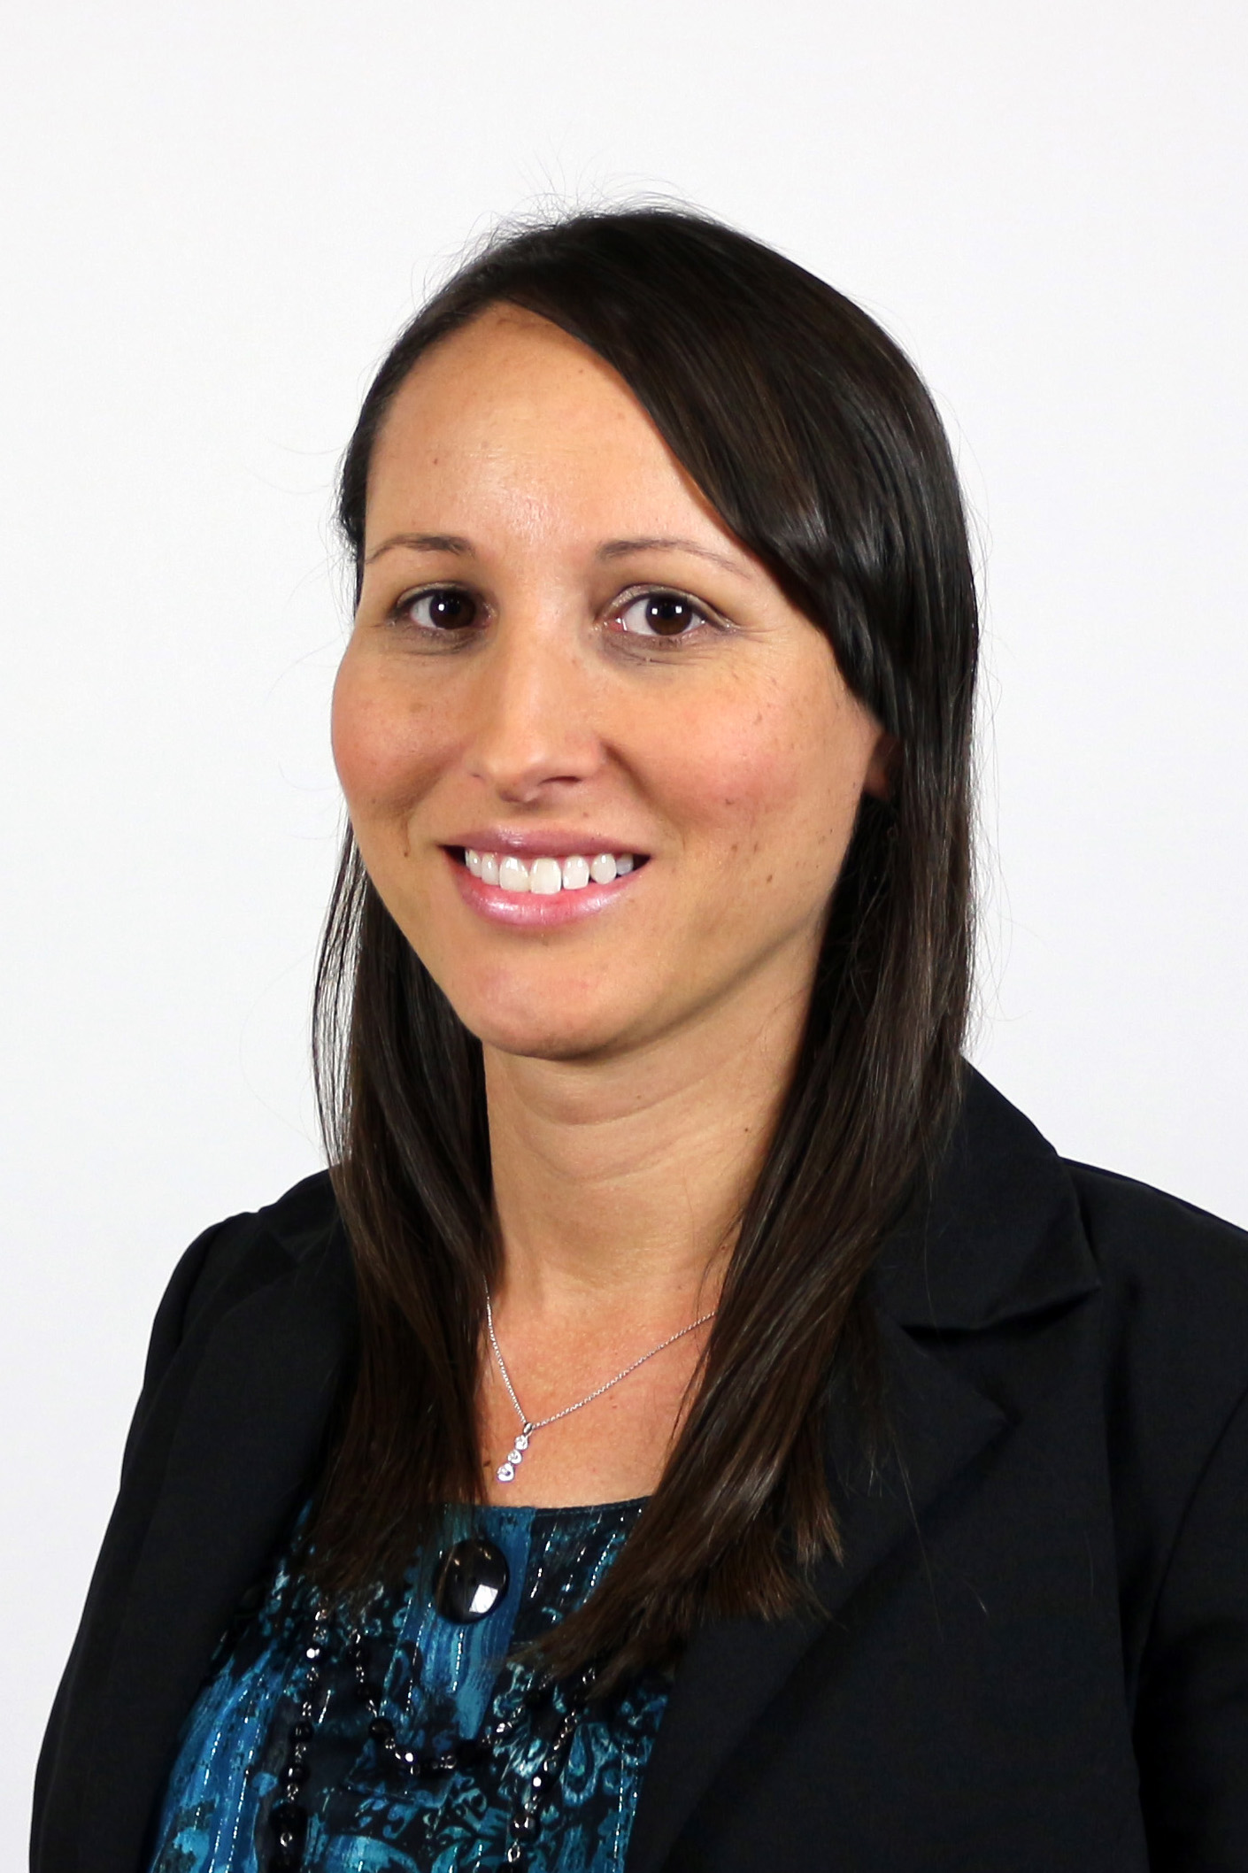
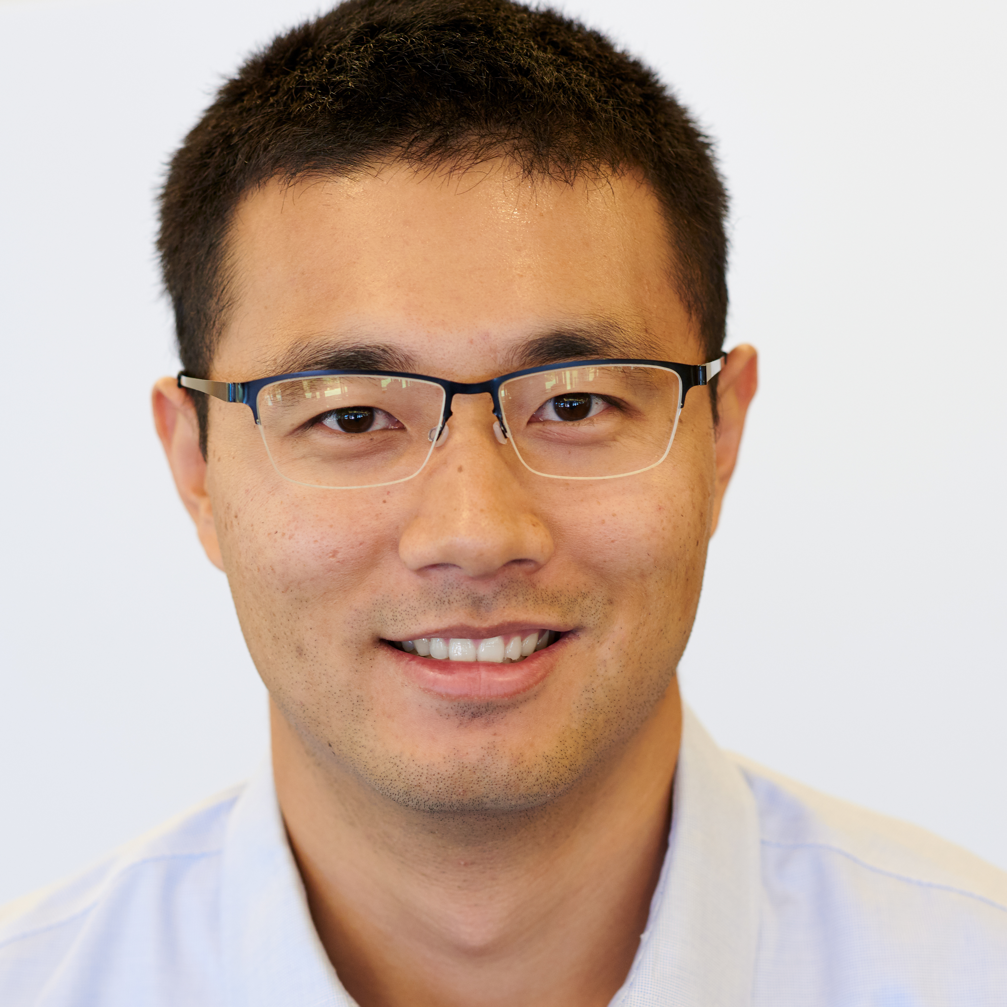
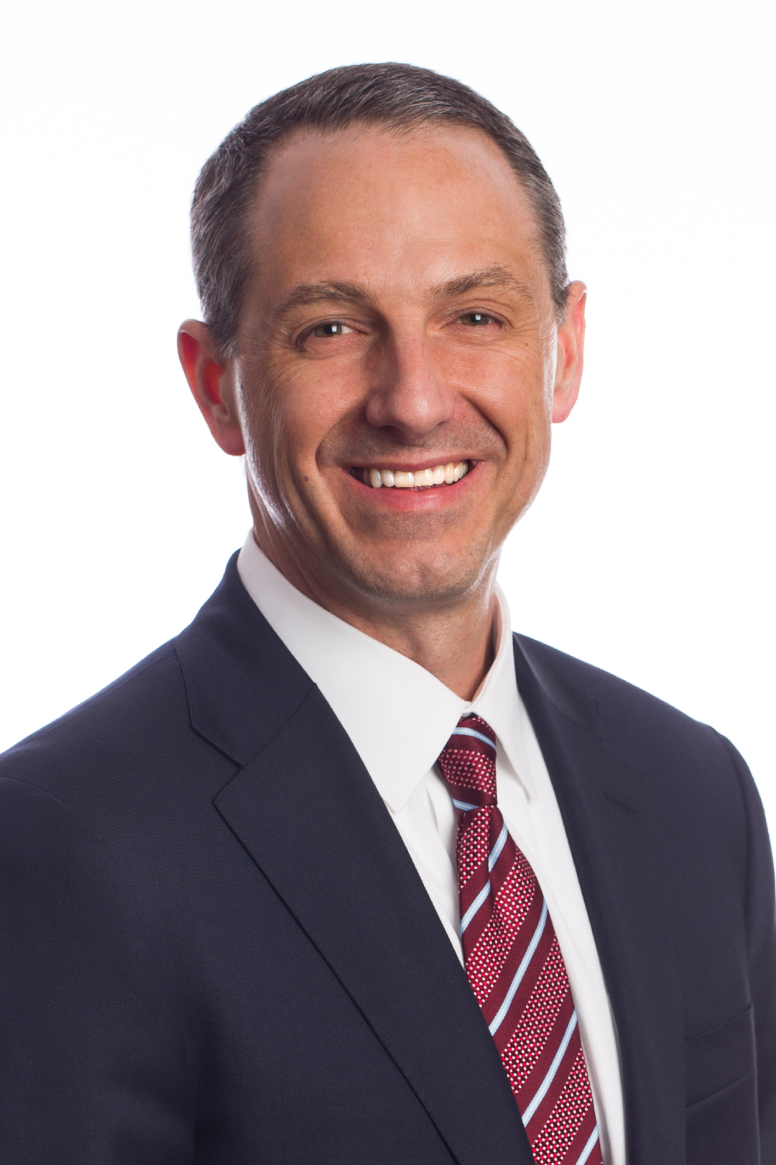
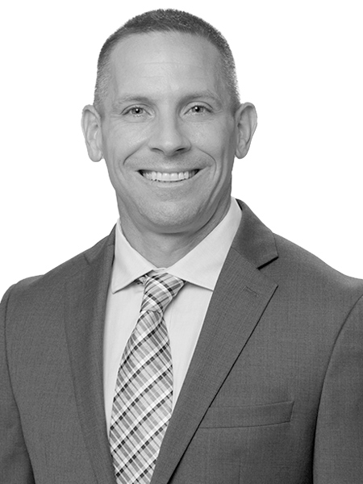
Current MSRE Instructors - Runstad Department of Real Estate - UW
Assoc. Prof. Arthur Acolin
RE 516: Real Estate Market Analysis
RE 540: Adv. RE Finance & Invest.
RE 563: Housing Markets and Policy
Prof. Steven Bourassa
RE 513: Introduction to RE Finance & Investment
Asst. Prof. Gregg Colburn
RE 508: Financial Modeling
RE 565: Adv. Housing Studies
Prof. Sofia Dermisi
RE 510: Introduction to RE
RE 532: RE Project Management
Assoc. Prof. Rebecca Walter
RE 562: Residential Data Analytics
RE 564: Affordable Housing
Asst. Prof. Ruoniu (Vince) Wang
RE 597: Real Estate Data Modeling
Shannon Affholter
RE 512: Leadership in the Built Environment
RE 514: Negotiations & Conflict resolution
RE 550: RE Development
RE552: RE Careers & Prof.Development
Aaron De Collibus
RE 541: RE Capital Markets

Slide 6
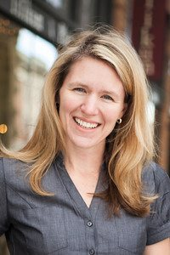
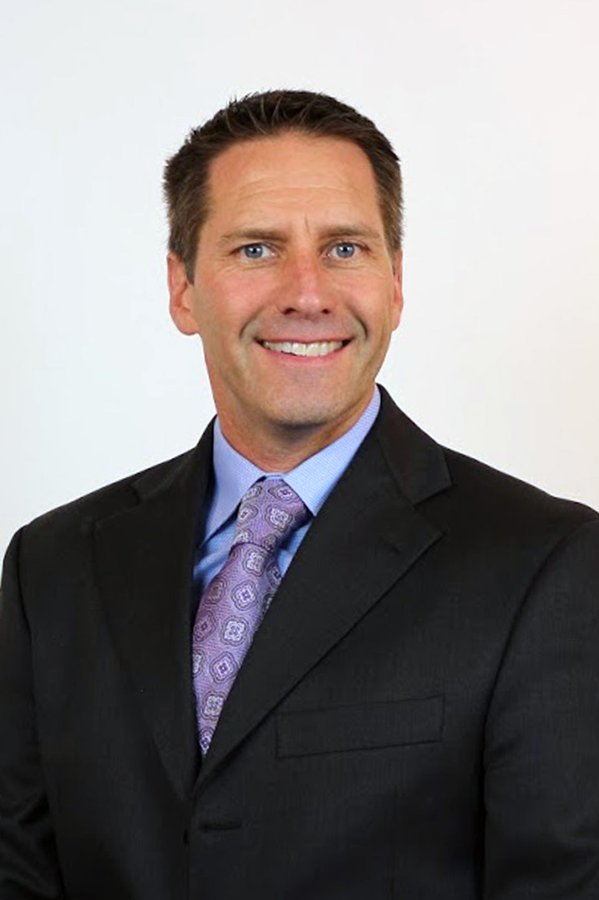
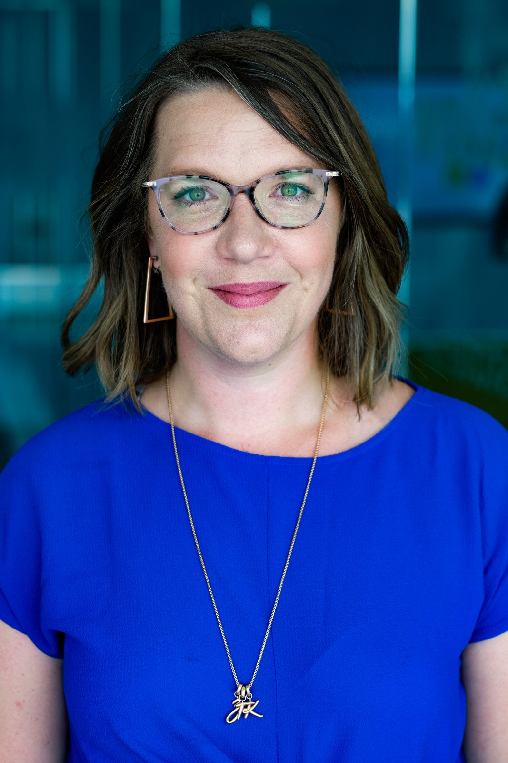
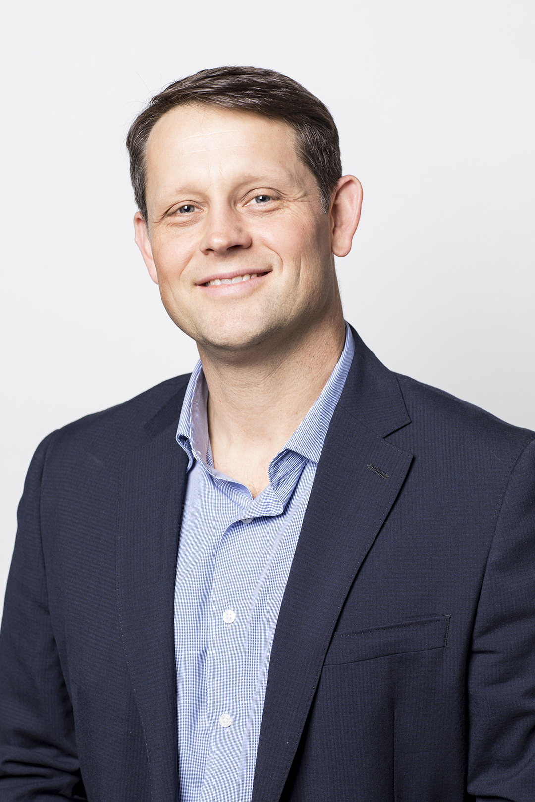
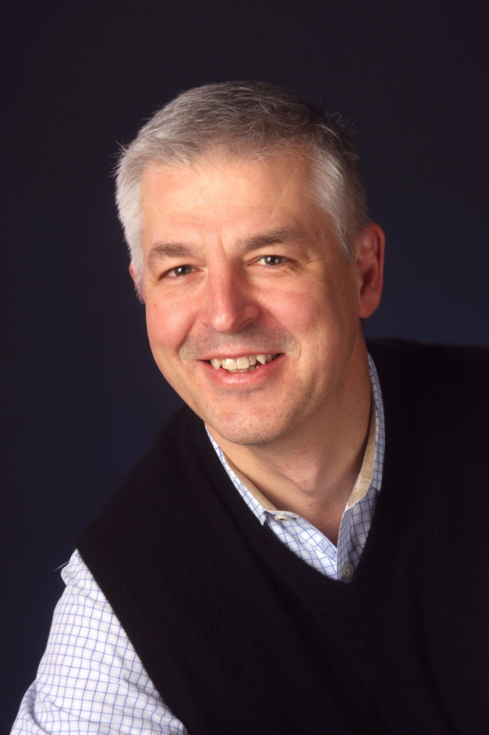
Current MSRE Instructors - Runstad Department of Real Estate - UW
Julie Howe
RE 563: Housing Markets and Policy
Kurt Kruckeberg
RE 515: RE Law
Jeff McCann
RE 551: RE Development Studio
Skylar Olsen
RE566: RE market evolution &
disruptions
Tim Overland
RE 511: RE Valuation & Appraisal
Amit Ranade
RE 515: RE Law
Pete Stone
RE 531: Risk & Portfolio Management

Slide 7
Master of Science in Real Estate - UW
Who should apply to the MSRE?
  Anyone, however, the undergraduate degree & coursework* taken allows students to apply for the MSRE under either Regular or Advanced MSRE standing
What is the difference between Regular & Advanced MSRE standing?
  Regular:
    Applicants with non-quantitative bachelor’s degrees (e.g. arts, humanities etc.)
    Length: 2 years (6 quarters) – full-time
    Total credits: 70
    Curriculum areas:
      Business skills - 15 credits; Technical & Software skills - 14 credits
      Real Estate Core - 27 credits; Capstone - 4 credits
      Electives - 10 credits
  Advanced:
    Applicants with quantitative bachelor’s degrees (e.g. business, RE, engineering/construction etc.)
    Length: 1 year (3 quarters) – full-time or 2 years- part-time
    Total credits: 41
    Curriculum areas:
      Business skills - 6 credits; Technical & Software skills: 4 credits
      Real Estate Core - 27 credits; Capstone: 4 credits
      Electives: 10 credits
* All transcripts will be reviewed for inclusion of quantitative courses [e.g. statistics, accounting/financial reporting, management, and visualization techniques(e.g. econometrics, programing, coding etc.)]to determine Advanced standing qualification.

Slide 8
Master of Science in Real Estate - UW

Slide 9
Master of Science in Real Estate - UW
Typical course sequencing Regular & Advanced MSRE standing
  Regular standing Advanced standing
  Full-time (6 quarters) Full-time (3 quarters)

Slide 10
Master of Science in Real Estate - UW
Application deadlines under Regular & Advanced MSRE standing?
  International students: January 15th
  Domestic students: January 15th(late applications will be considered, however, scholarships or placement cannot be guaranteed)
Tuition difference between Regular & Advanced MSRE standing?
  Regular:
    Time length: 2 years (6 quarters) – full-time
    Total Tuition (estimate): $36,824 (resident), $73,648 (non-resident)
    Scholarships/financial aid: Eligible
  Advanced:
    Time length: 1 years (3 quarters) – full-time or 2 years – part-time
    Total Tuition (estimate) : $18,412 (resident), $37,630 (non-resident)
    Scholarships /financial aid : Eligible
Western Regional Graduate Program (WRGP) tuition reduction:
Students from the following 14 states/2 territories are eligible for resident tuition: Alaska, Arizona, California, Colorado, Hawaii, Idaho, Nevada, Montana, North Dakota, New Mexico, South Dakota, Oregon, Wyoming, Utah, Guam, and Northern Mariana Islands.
Multiple recruitment scholarships are available, and all students can indicate an interest with their application

Slide 11
What are the Real Estate Career Options?
ADVISORY
DEVELOPMENT
BANKING & FINANCE
INVESTMENT MANAGEMENT
CORPORATE REAL ESTATE
PUBLIC POLICY
BROKERAGE
DEVELOPMENT COMPANIES
COMMERCIAL BANKS
INSTITUTIONAL INVESTORS
CORPORATIONS
COMMUNITY AND ECONOMIC DEVELOPMENT
REAL ESTATE SERVICE FIRMS
HOMEBUILDERS
INVESTMENT BANKS
REITS
ADVISORY FIRMS
HOUSING AUTHORITIES AND NONPROFIT DEVELOPERS
INVESTMENT ADVISORY
CAPITAL MARKETS
FUND MANAGERS
STATE HOUSING FINANCE AGENCY
RESEARCH
CREDIT RATING AGENCIES
ASSET MANAGEMENT
ACCOUNTING FIRMS

Slide 12
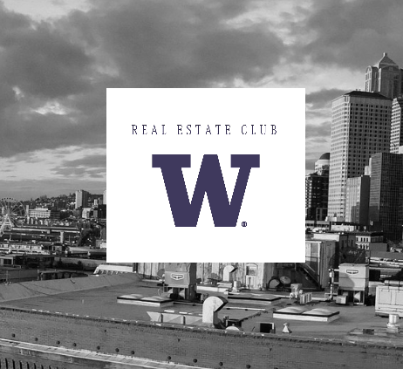
Real Estate Club
Opportunity to connect with real estate professionals
See complex and interesting development projects during and after construction
Share your passion for real estate with fellow students
Attend Lunch and Learns to meet with real estate professionals
Events: http://www.uwreclub.com
Contact: UWREClub@gmail.com

Slide 13
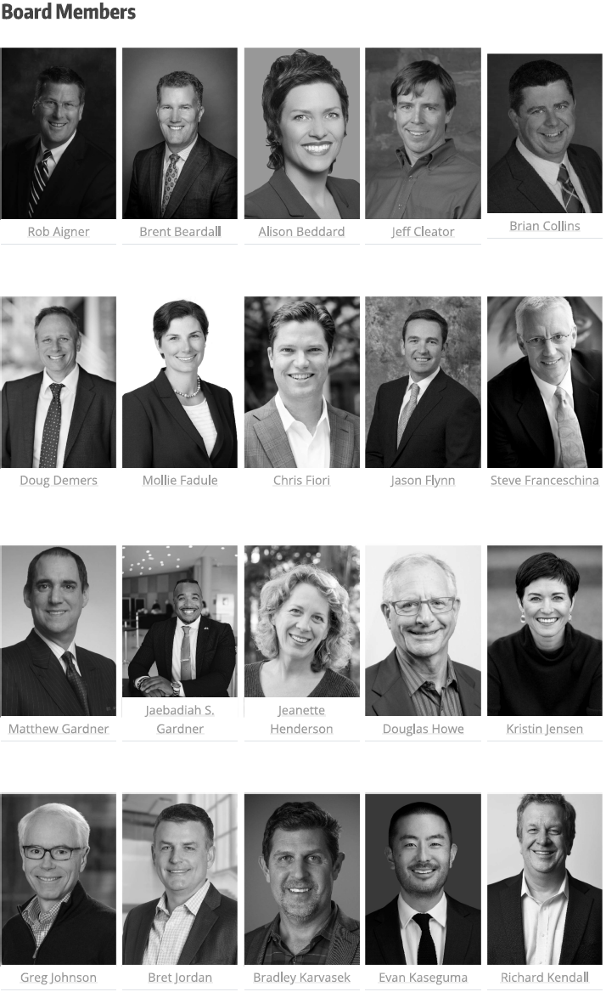
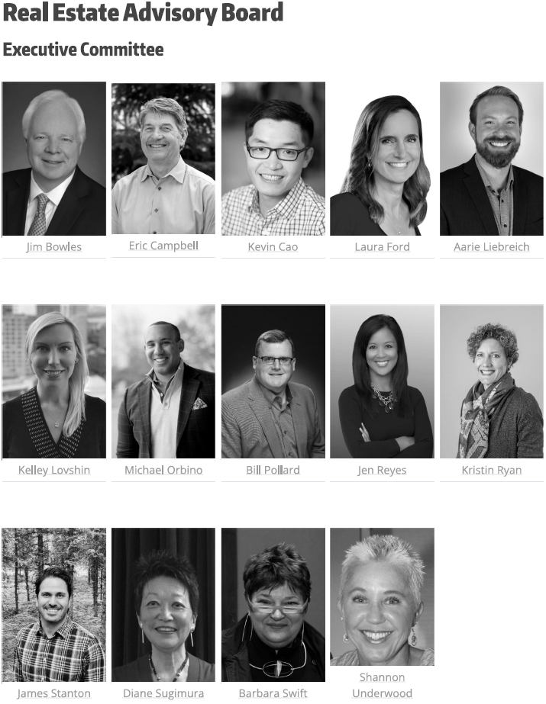
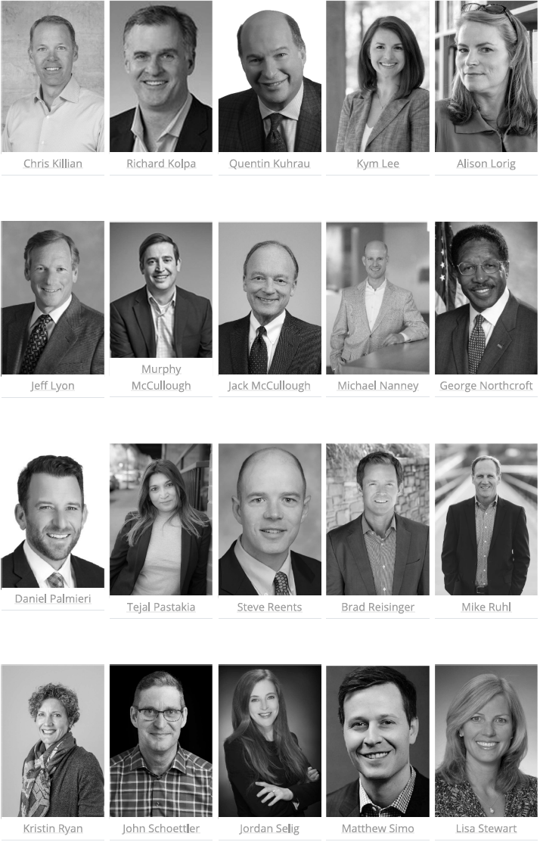
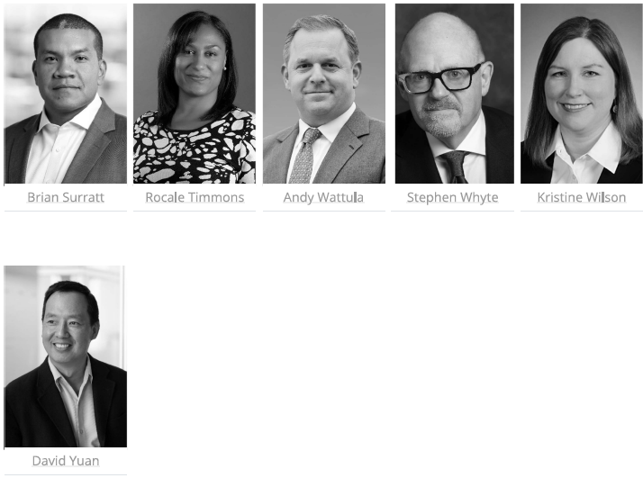
Real Estate Community
Mentors
Alumni
Advisory Board
More info: http://realestate.washington.edu/re-people/community/
Contact: msre@uw.edu
Alumni contact: uwrealestatealumni@gmail.com

Slide 14
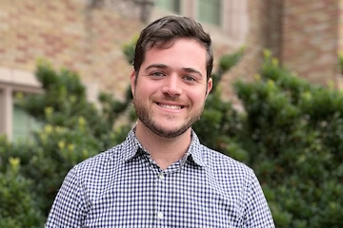
Master of Science in Real Estate/UW – Program Contact
Program Contact
Eli Heller Graduate Program Advisor & Career Coach Email: msre@uw.edu
General information:
http://www.seattle.gov/
MSc Real Estate:
https://re.be.uw.edu/
International Student Service UW
http://iss.washington.edu

Slide 15
Master of Science in Real Estate - UW
Why consider the MSRE at UW?
  Students with quantitative backgrounds can fast-track the completion of the degree in 3-quarters
  Students can specialize in Corporate Real Estate, which is unique among real estate degrees
  All MSRE students regardless of standing (regular or advanced) can transfer a max of 6 credits not used for their undergraduate degree towards the MSRE
  The UW/MSRE is designated as a STEM degree, which is rare across RE programs (international students - eligible for max 3 years post-graduation U.S. work)
  The Runstad Department of Real Estate benefits from a very active Advisory Board of leading area professionals and alumni network willing to engage with students and help them in their future endeavors
  Seattle is home of 11 fortune 500 companies among others, in need of real estate expertise

Slide 16


Thank you
Questions??
Master of Science in Real Estate

